Slide 1

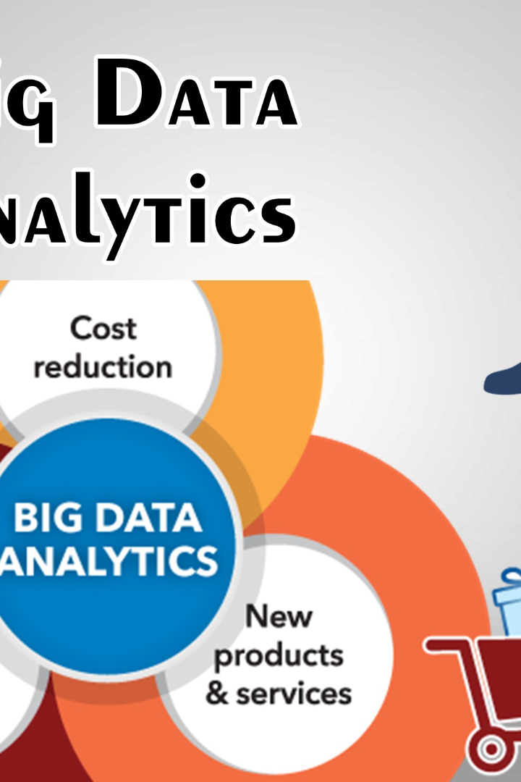

Big Data Analytics with IBM Cloud
Discover the power of big data analytics using the IBM Cloud platform. Learn how to load and preprocess datasets to begin building your own big data analytics project.
AR
by Ahmed Riyas kaan

Slide 2

Introduction to Big Data Analytics
1
Data Exploration
2
Predictive Analysis
Delve into large and complex datasets to extract valuable insights and patterns.
Utilize statistical techniques and machine learning algorithms to forecast future outcomes.
3
Data Visualization
Create compelling visual representations to better understand and communicate your findings.

Slide 3
Overview of IBM Cloud
Infrastructure
Services
Security
Access a vast range of computing resources, storage, and networking options.
Explore a comprehensive suite of tools and services tailored for big data analytics.
Ensure data privacy and protection with IBM's advanced security measures.

Slide 4
Loading Datasets into IBM Cloud
1
Collect
Identify relevant datasets and sources to gather valuable data for your analytics project.
Upload
2
Transfer the datasets to IBM Cloud using efficient and secure data transfer methods.
3
Verify
Ensure data integrity and accuracy by performing validation checks on the uploaded datasets.

Slide 5
Preprocessing Data in IBM Cloud
Data Cleaning
Data Integration
Data Transformation
Remove inconsistencies, errors, and missing values from the datasets to ensure high-quality data.
Combine multiple datasets into a unified format to enable meaningful analysis.
Normalize, scale, or reshape data for better compatibility with analytics algorithms.

Slide 6
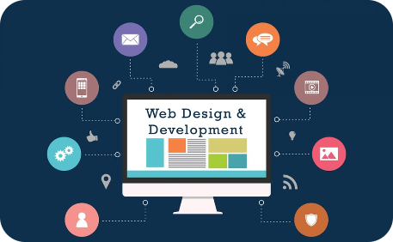

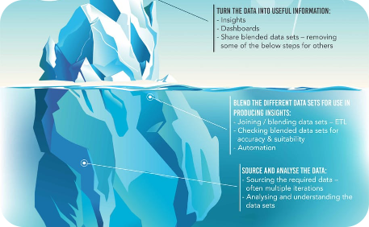
Building a Big Data Analytics Project
Design
Implementation
Evaluation
Create a well-defined project plan and define the objectives and scope of your analytics project.
Utilize programming languages and libraries to develop algorithms and models for analysis.
Assess the performance of your analytics solutions and validate the accuracy of the generated insights.

Slide 7
Challenges in Big Data Analytics
Data Quality
Scalability
Privacy
Address issues related to incomplete or inconsistent data that can lead to biased results.
Handle the volume, variety, and velocity of big data to ensure efficient processing and analysis.
Manage privacy concerns and comply with data protection regulations to maintain trust.

Slide 8
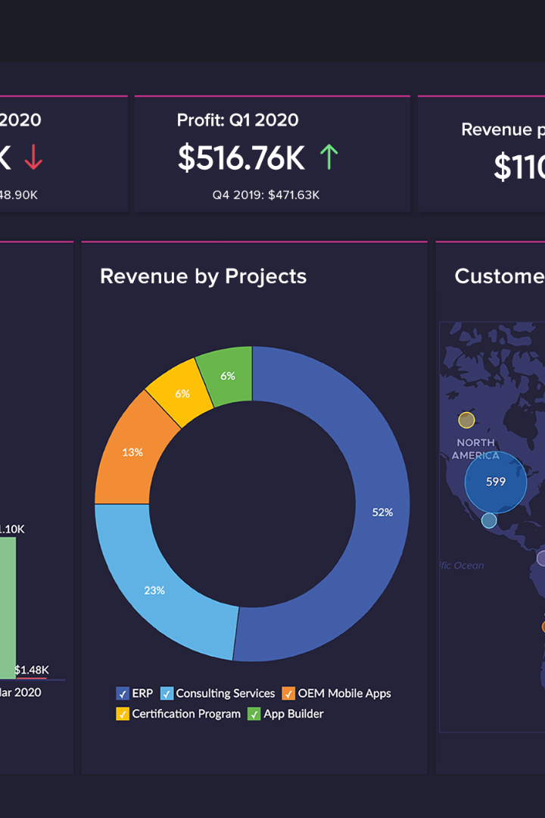
Conclusion and Next Steps
Explore the limitless possibilities of big data analytics with IBM Cloud. Start your journey today and unlock valuable insights to drive data-driven decision-making.

